Slide 1








SPA with React and REST
Creating Single Page Apps (SPA) with React, AJAX, REST and Kinvey
SPA, AJAX ReactJS,
Kinvey
AJAX
REST
SoftUni Team
Technical Trainers
Kinvey
Software University
http://softuni.bg

Slide 2



Table of Contents
The Book Library App
The Kinvey Back-End
Creating React App
App Skeleton: React Components + Views
Login / Register / Logout
Create List / Edit / Delete Books (CRUD Operations)

Slide 3
Have a Question?
sli.do #spa-react

Slide 4
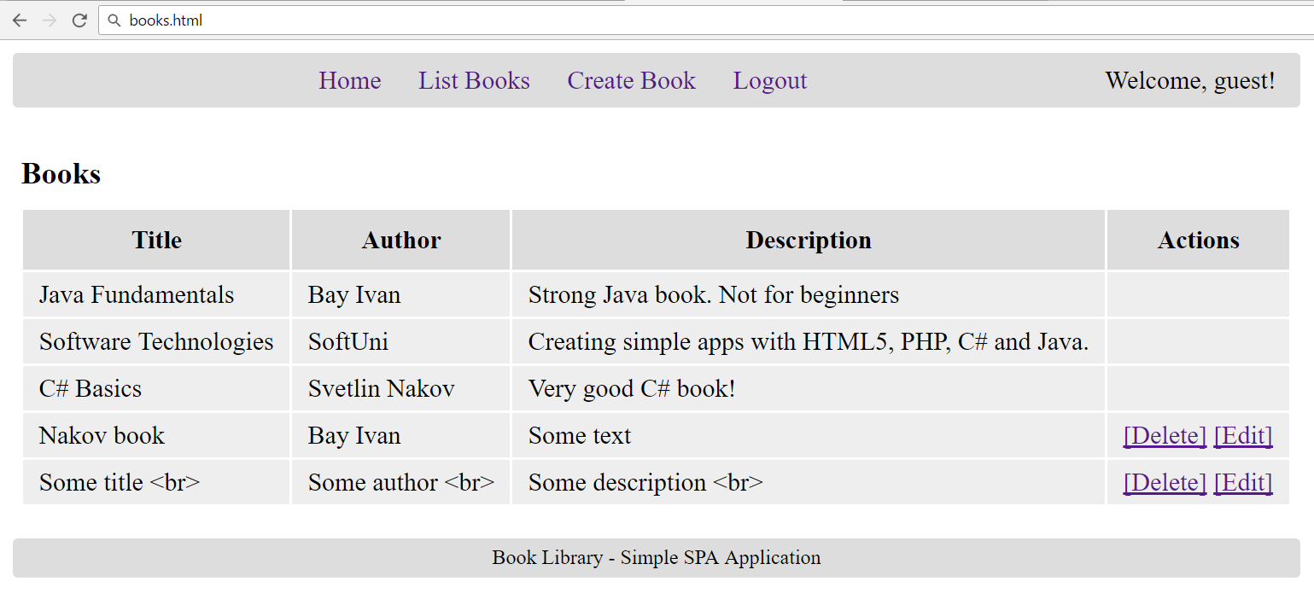
The Book Library Project
Book Library: CRUD + Login / Logout

Slide 5
The "Book Library" App
Design and implement a “Book Library” front-end single-page application (SPA) in HTML5 with REST back-end in Kinvey
Books have title, author and description
Implement the following functionality:
Login, register, logout, list all books, create a new book, edit existing book, delete existing book
Books have ownership:
Anyone can view all the books
Only the book creator can edit / delete his own books

Slide 6
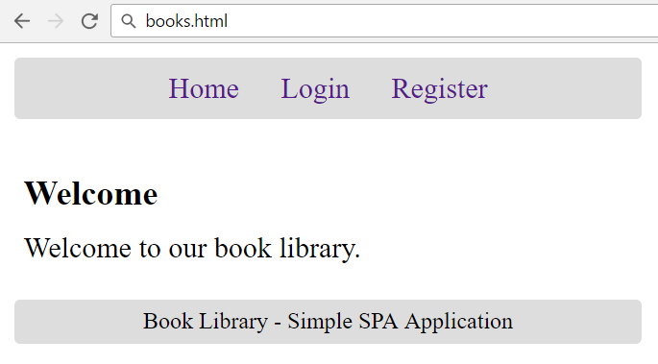
Home Screen

Slide 7
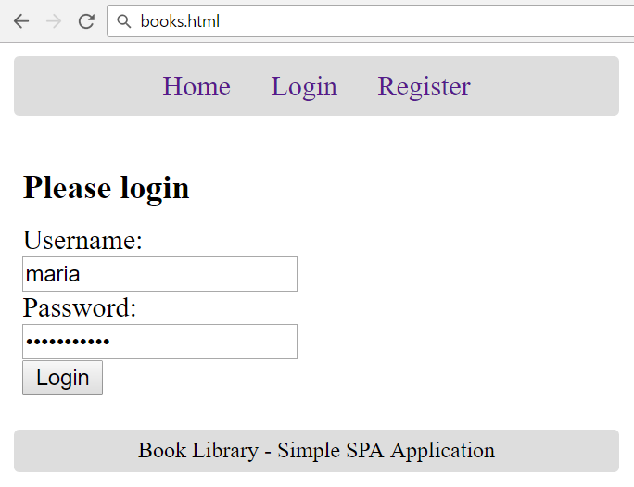
Login Screen

Slide 8
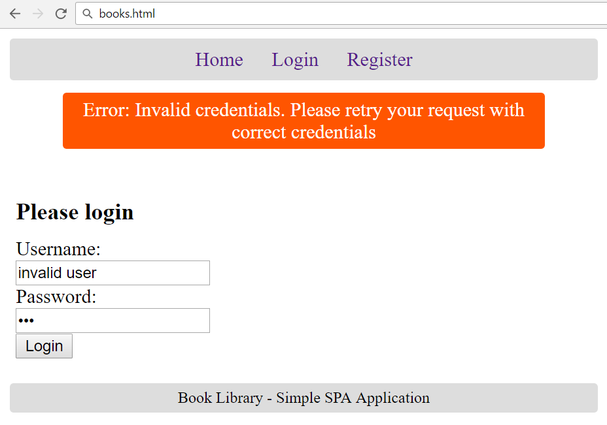
Login Screen: Invalid Login

Slide 9
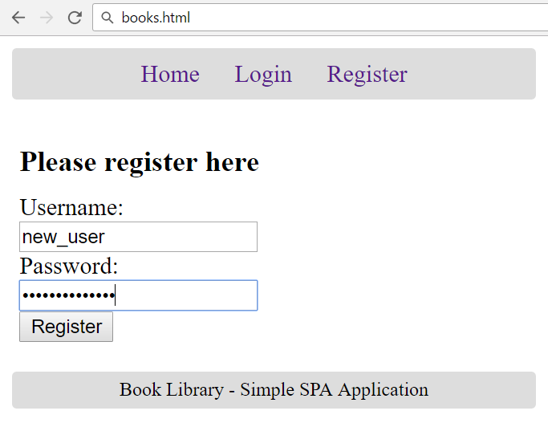
Register Screen

Slide 10
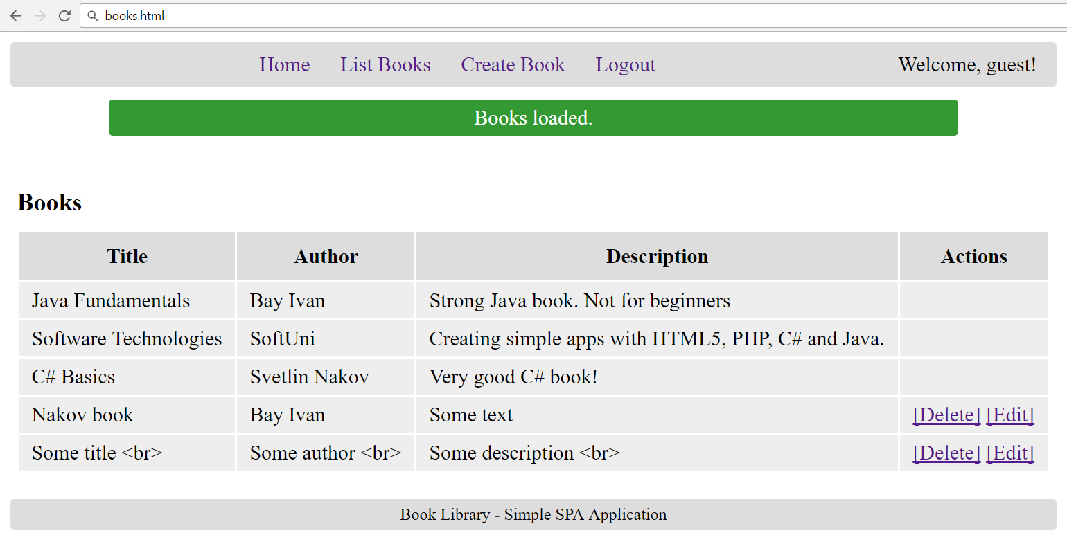
List Books Screen

Slide 11

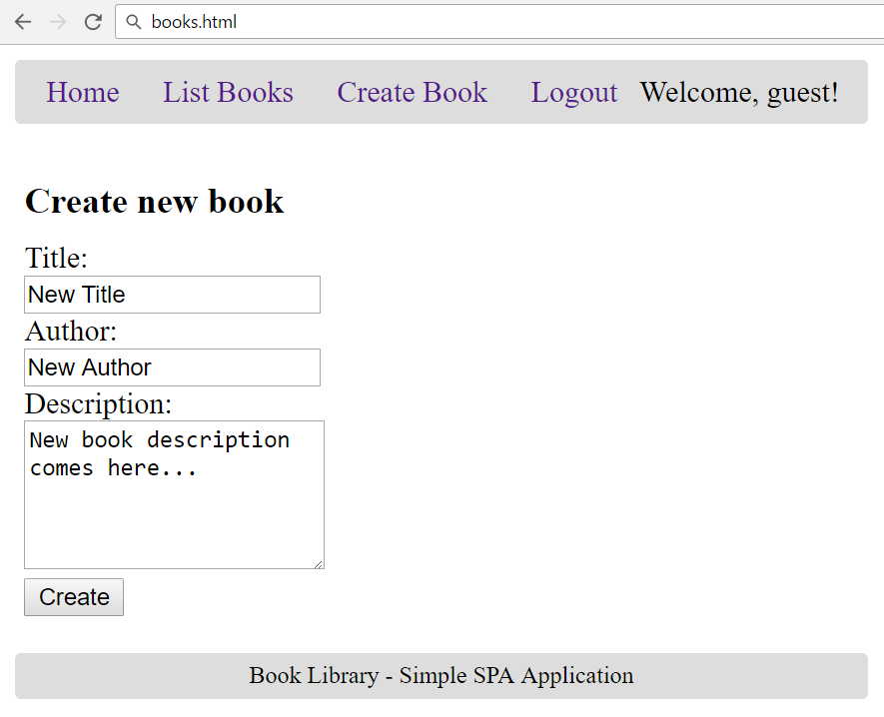
Create Book Screen

Slide 12
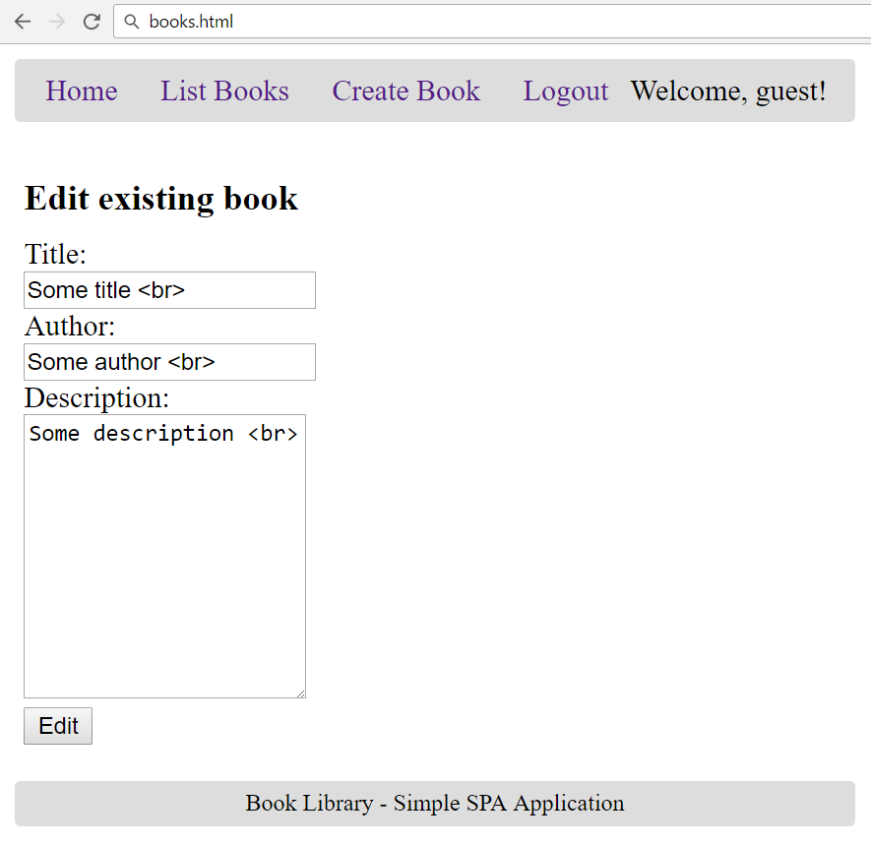
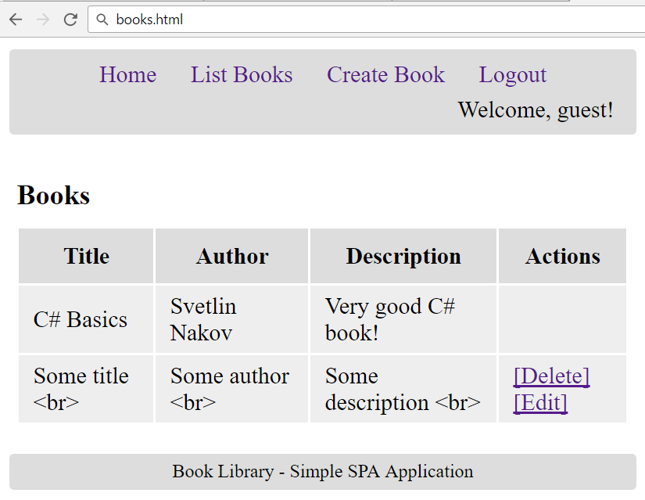
Edit Book Screen

Slide 13
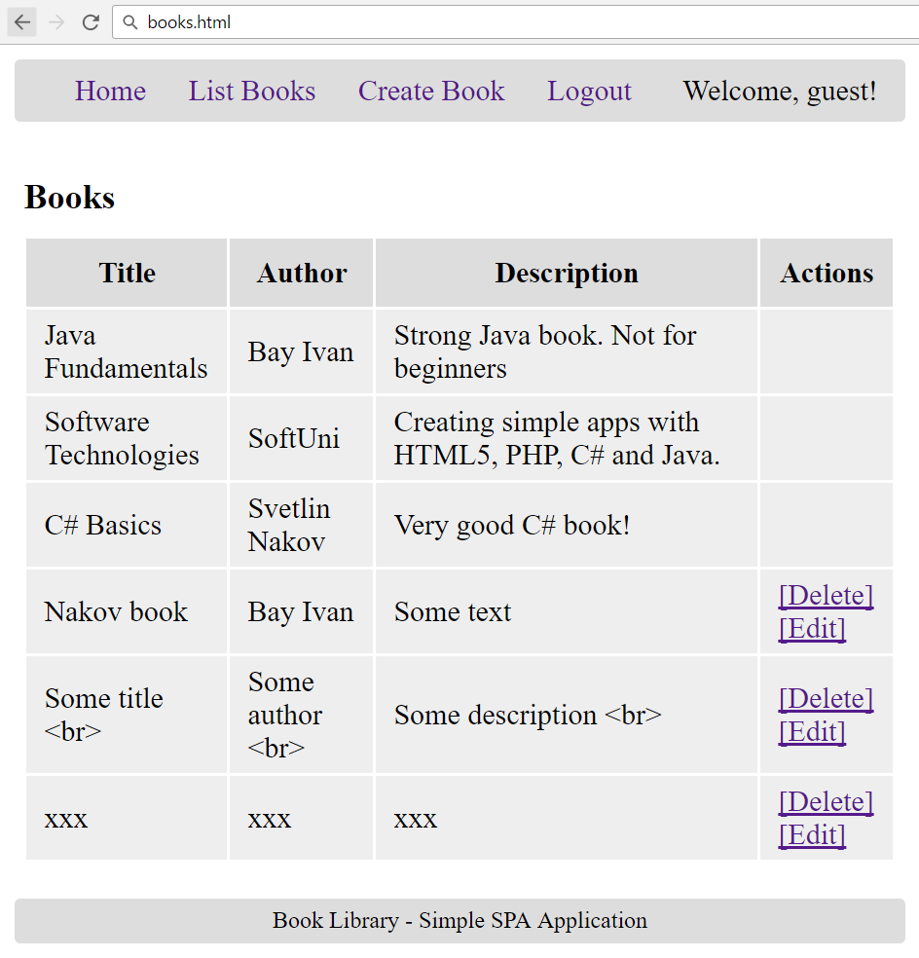
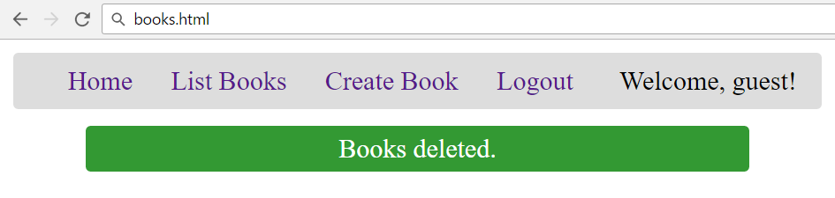
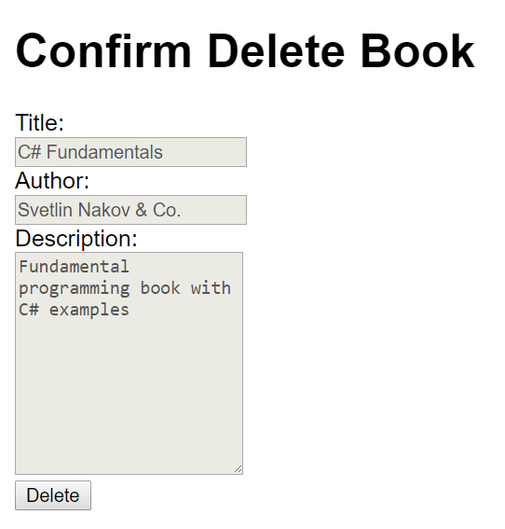
Delete Book Screen

Slide 14
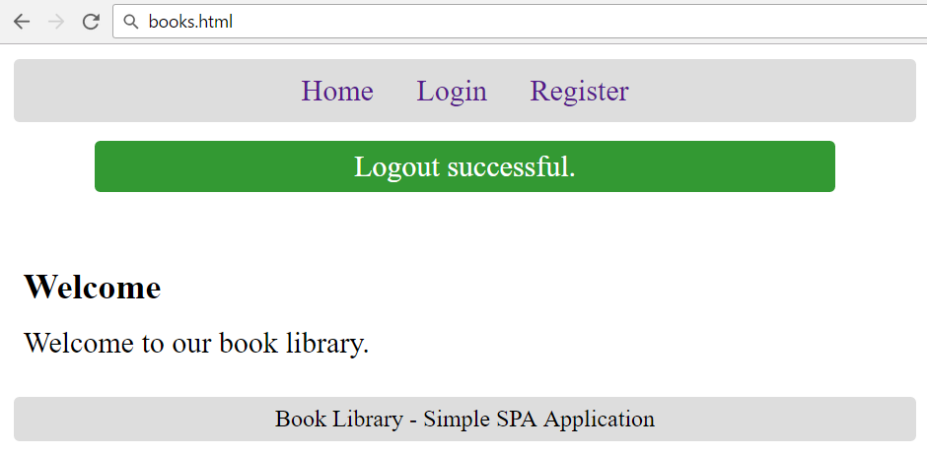
Logout Screen

Slide 15
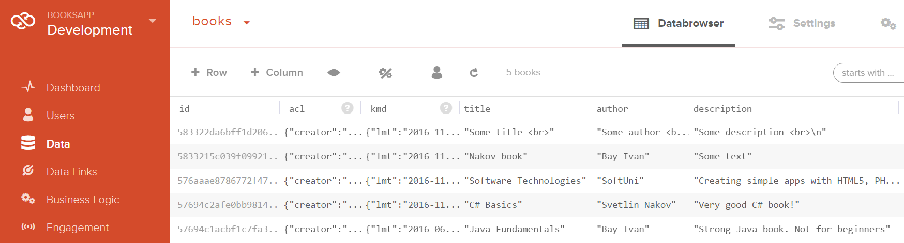
The Kinvey-Based Back-End
Users and Books Collections

Slide 16
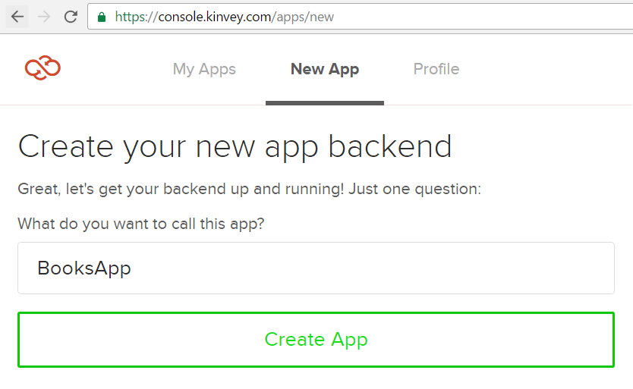
Create Kinvey App

Slide 17
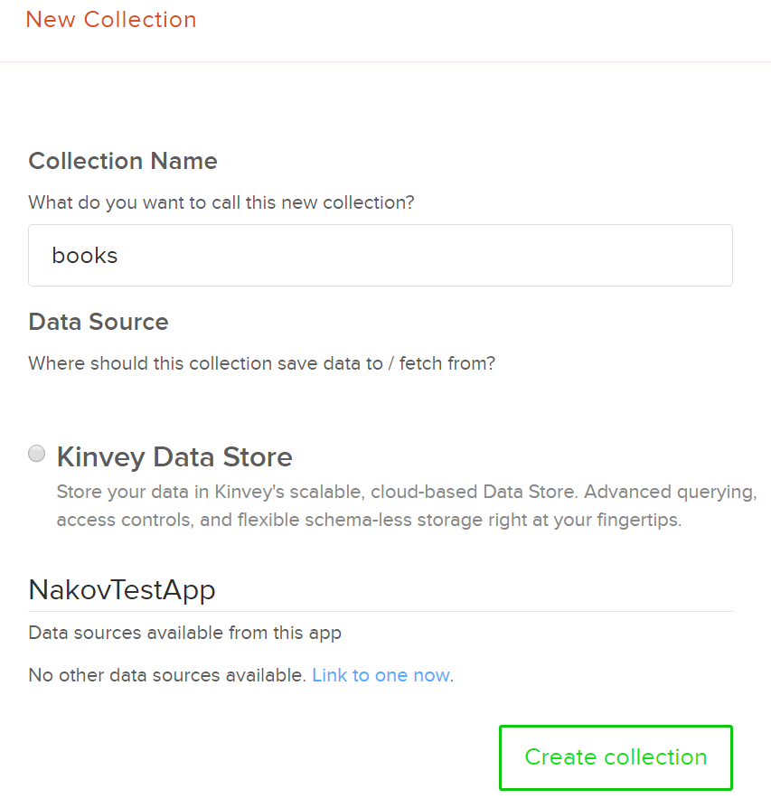
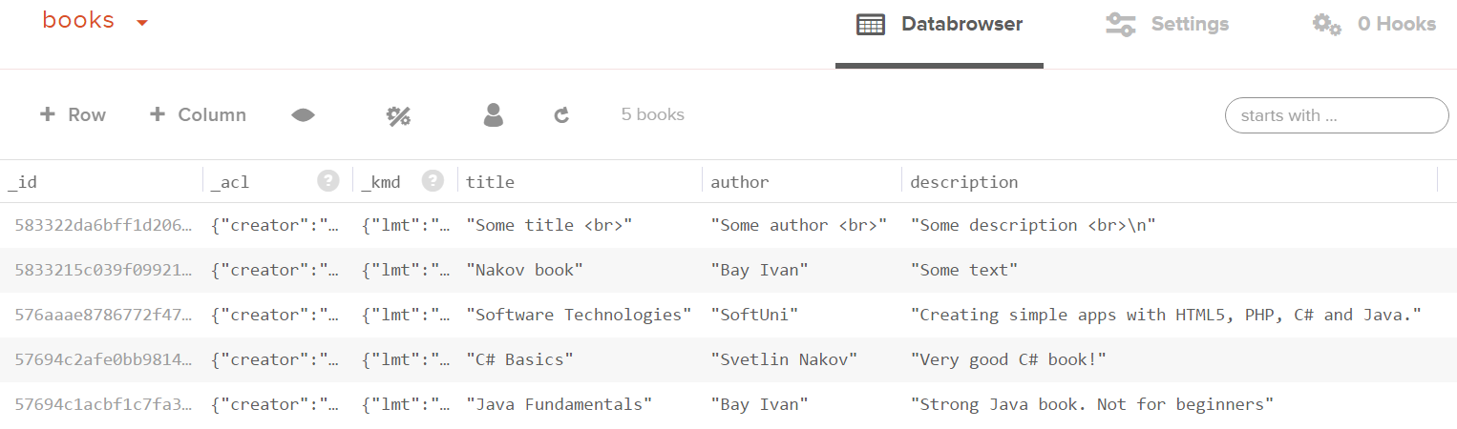
Create Books Collection
Create a collection "books"
Add a few books
Columns: title + author + description

Slide 18
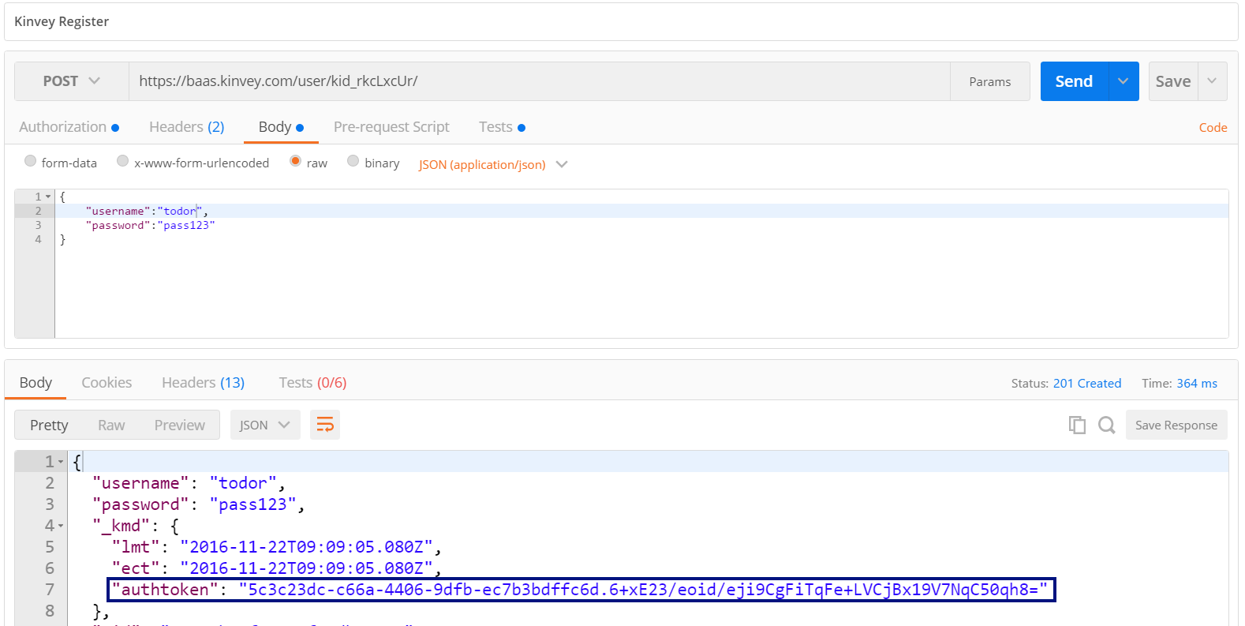
Test the Kinvey Back-End: Register User
POST
https://baas.kinvey.com/user/{app_id}/
Authorization: Basic base64(app_id:app_secret)
{"username":"todor", "password":"pass123"}

Slide 19
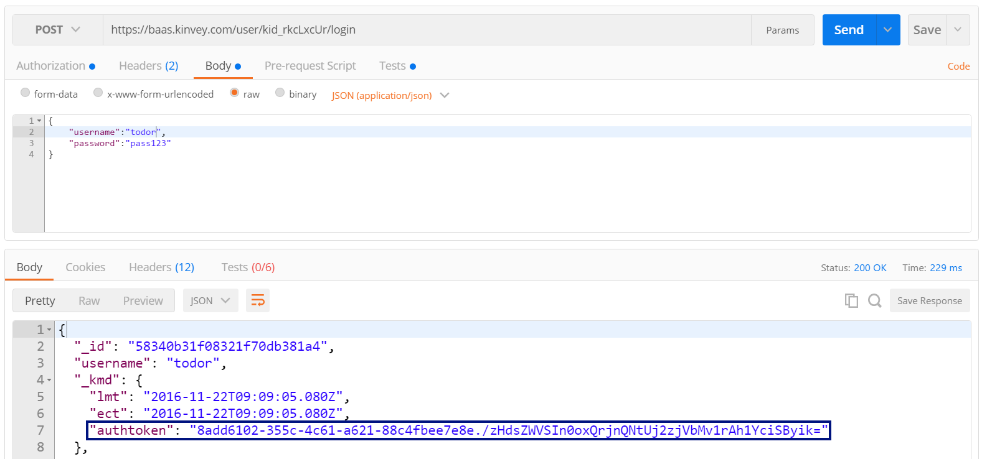
Test the Kinvey Back-End: Login User
POST
https://baas.kinvey.com/user/{app_id}/login
Authorization: Basic base64(app_id:app_secret)
{"username":"todor", "password":"pass123"}

Slide 20
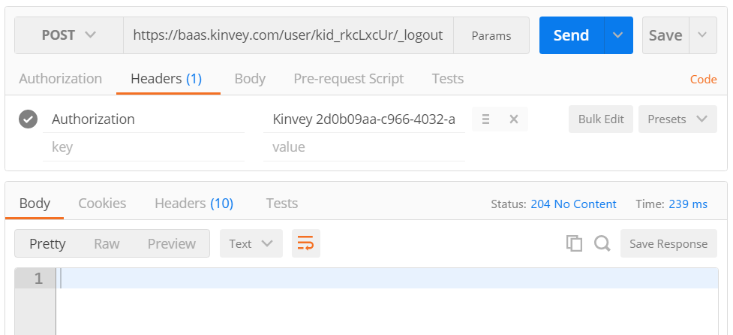
Test the Kinvey Back-End: Logout
POST
https://baas.kinvey.com/user/{app_id}/_logout
Authorization: Kinvey authtoken

Slide 21
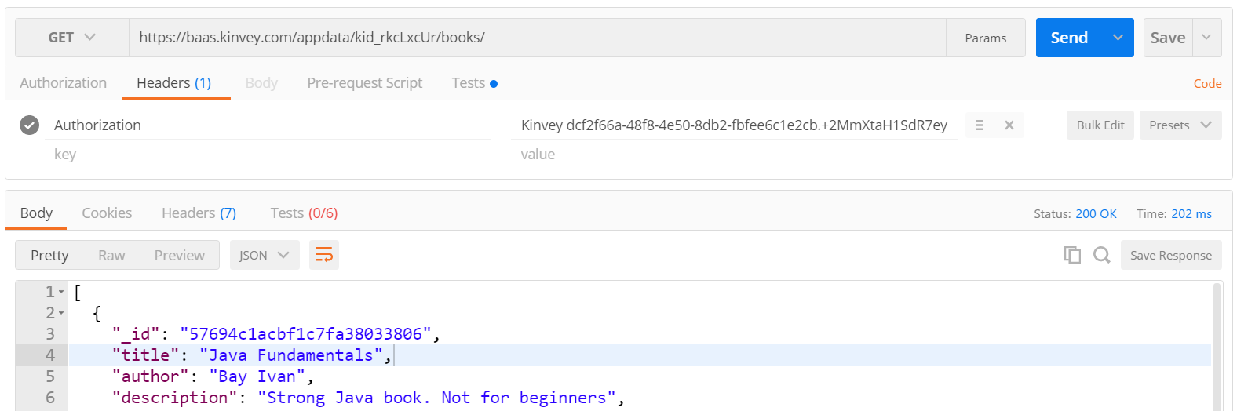
Test the Kinvey Back-End: List All Books
GET
https://baas.kinvey.com/appdata/{app_id}/books
Authorization: Kinvey authtoken

Slide 22
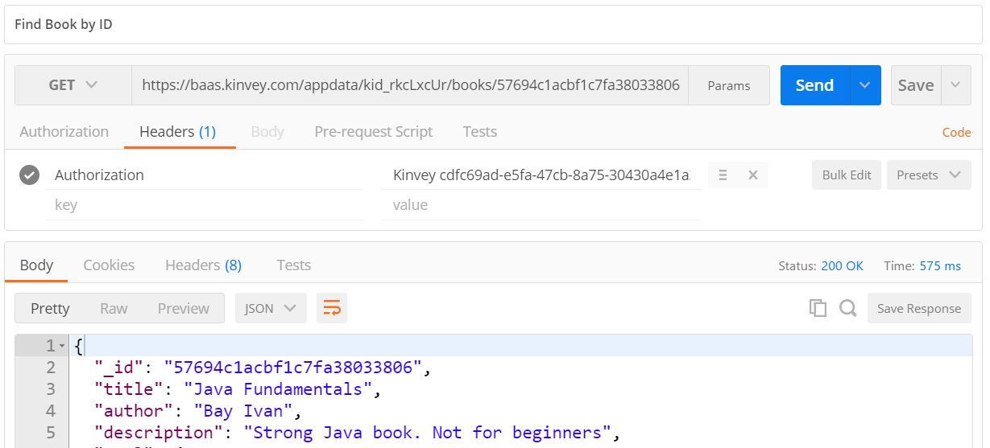
Test the Kinvey Back-End: Find Book by ID
GET
https://baas.kinvey.com/appdata/{app_id}/books/{id}
Authorization: Kinvey authtoken

Slide 23
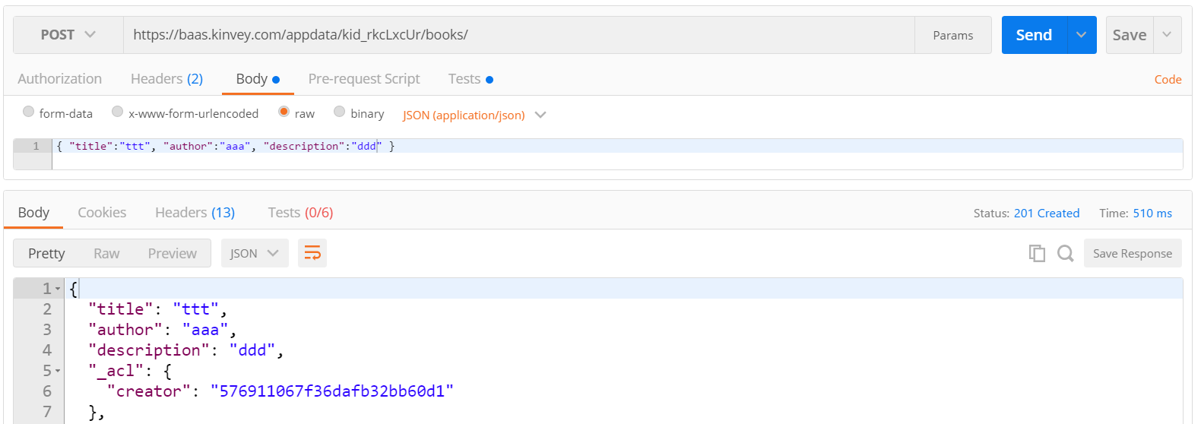
Test the Kinvey Back-End: Create New Book
POST
https://baas.kinvey.com/appdata/{app_id}/books
Authorization: Kinvey authtoken
{ "title":"ttt", "author":"aaa", "description":"ddd" }

Slide 24
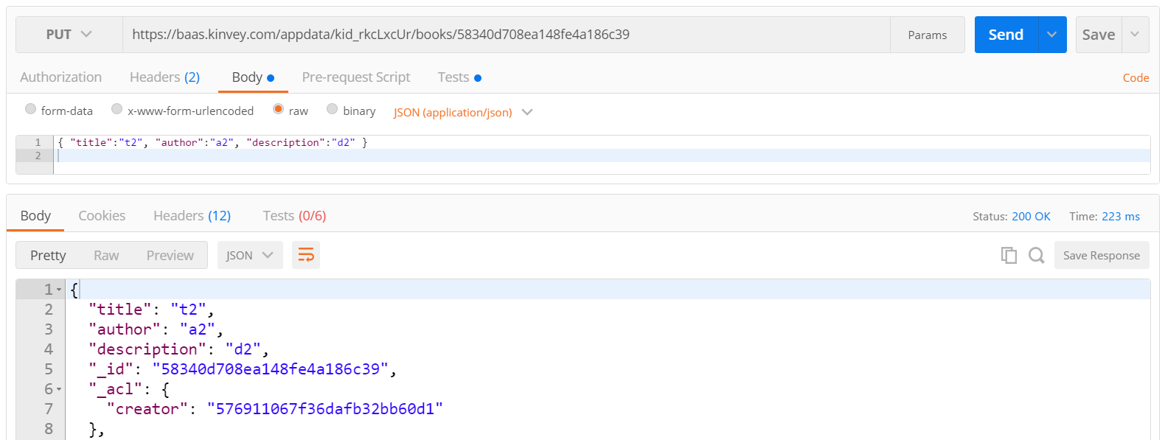
Test the Kinvey Back-End: Edit Book
PUT
https://baas.kinvey.com/appdata/{app_id}/books/{id}
Authorization: Kinvey authtoken
{ "title":"t2", "author":"a2", "description":"d2" }

Slide 25
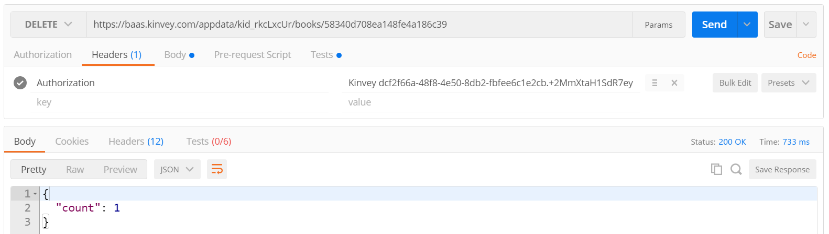
Test the Kinvey Back-End: Delete Book
DELETE
https://baas.kinvey.com/appdata/{app_id}/books/{id}
Authorization: Kinvey authtoken

Slide 26
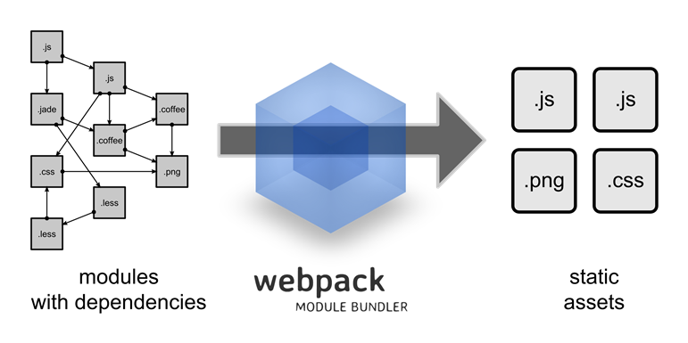


Setup React Server-Side Build
Configuring the Development Environment

Slide 27
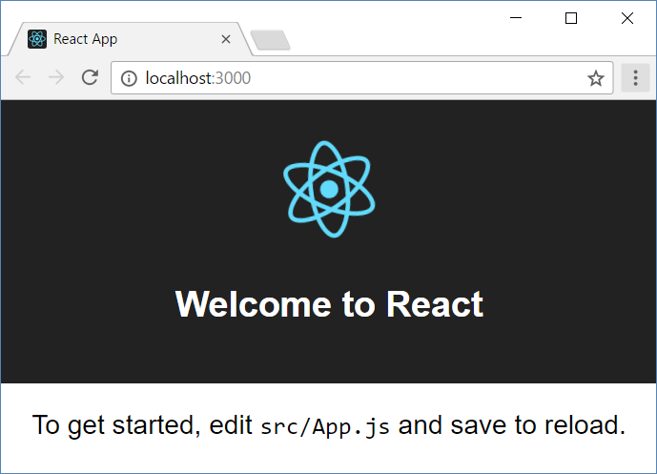
Install and Run the React App Creator
Install the React app creator (on-time global install):
Run the React app creator (this is very slow: ~5-10 minutes!)
Starts your React app from the command line
Browse you app from http://localhost:3000
npm -g install create-react-app
create-react-app React-Book-Library
npm start

Slide 28
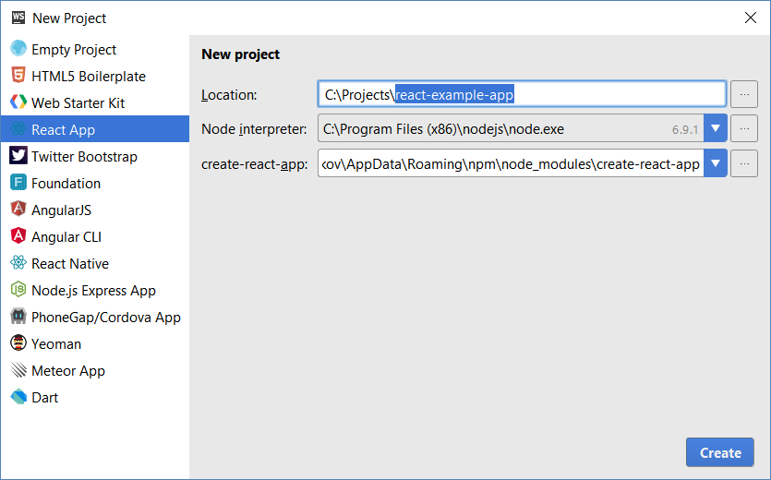
React Apps with WebStorm

Slide 29
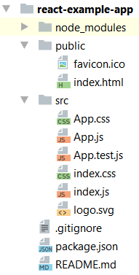
React App Structure
package.json – project configuration
Module name, dependencies, build actions
index.html
App main HTML file
index.js
App main JS file (startup script)
App.js, App.css, App.test.js
React component "App"

Slide 30
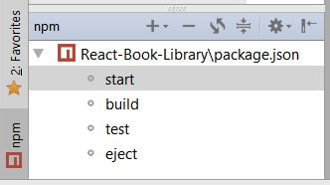
Run the React App
Run the React app from the console
Run the React app from WebStorm
npm start

Slide 31
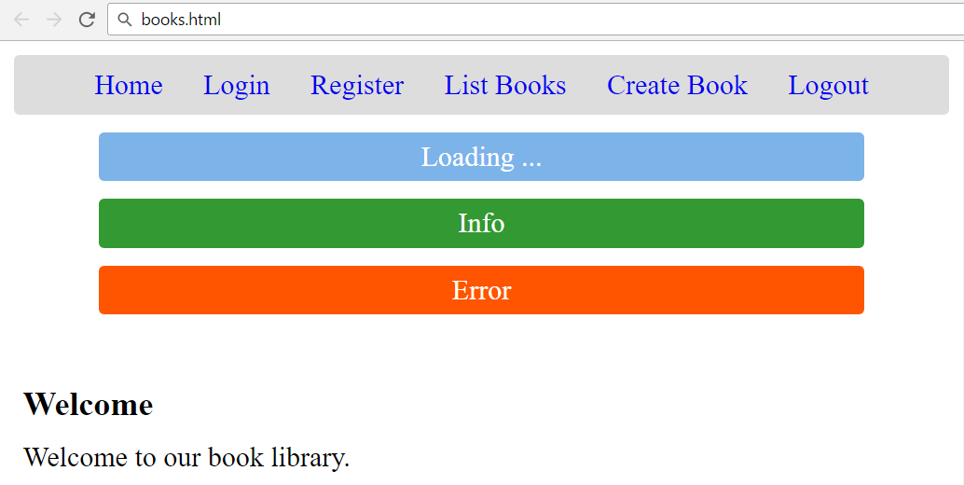
Create the Application Skeleton
React App + Components + Views

Slide 32
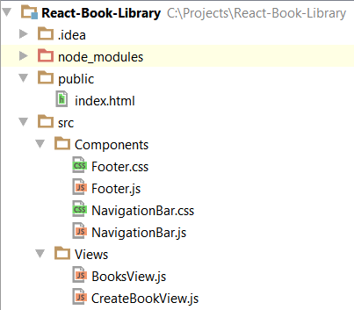
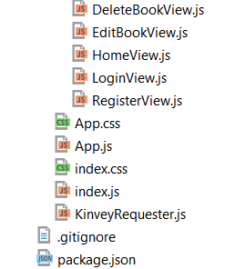
Create the Project Structure

Slide 33
Start with the HTML Page: index.html
<!DOCTYPE html>
<html lang="en">
<head>
<meta charset="utf-8">
<title>Book Library (React App)</title>
</head>
<body>
<div id="app"></div>
</body>
</html>

Slide 34
Main App Script: index.js
import React from 'react';
import ReactDOM from 'react-dom';
import App from './App';
import './index.css';
ReactDOM.render(<App />,
document.getElementById('app'));

Slide 35
Main App Styles: index.css
body {
margin: 0;
padding: 0;
font-family: sans-serif;
}

Slide 36
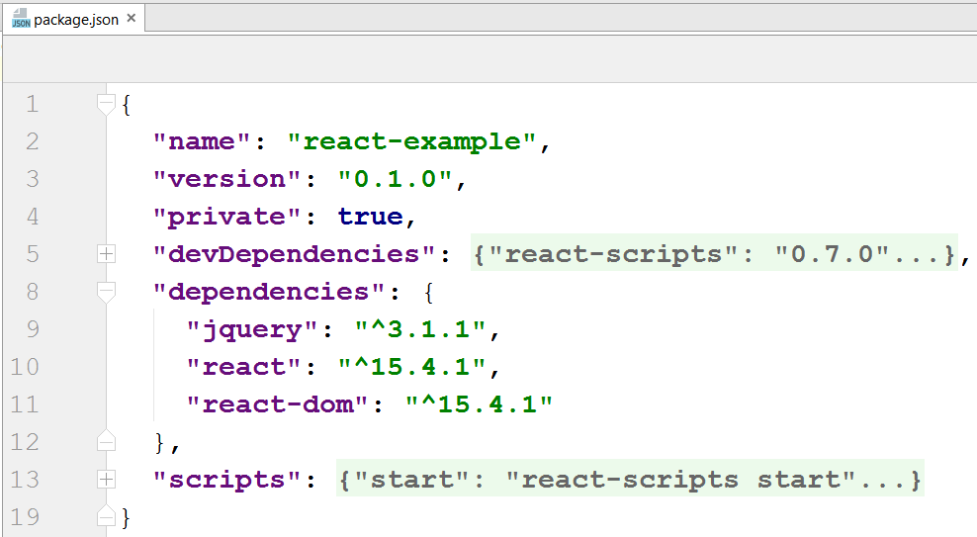
Install jQuery from Node Package Manager
npm install --save jquery

Slide 37
Main App Code: App.js
Start from some imports
import React, { Component } from 'react';
import ReactDOM from 'react-dom';
import './App.css';
import NavigationBar from './Components/NavigationBar';
import Footer from './Components/Footer';
import $ from 'jquery';

Slide 38
Main App Code: App.js
export default class App extends Component {
constructor(props) {
super(props);
this.state = {
username: sessionStorage.getItem("username"),
userId: sessionStorage.getItem("userId")
};
}
The app state will hold the currently logged in username + userId

Slide 39
Main App Code: App.js – render()
render() {
return <div className="App">
<header>
<NavigationBar … />
<div id="loadingBox">Loading ...</div>
<div id="infoBox">Info</div>
<div id="errorBox">Error</div>
</header>
<main id="main"></main>
<Footer />
</div>
}

Slide 40
Main App Code: Navigation Bar Component
Use bind(this) to fix the "lost this" problem
<NavigationBar
username={this.state.username}
homeClicked={this.showHomeView.bind(this)}
loginClicked={this.showLoginView.bind(this)}
registerClicked={this.showRegisterView.bind(this)}
booksClicked={this.showBooksView.bind(this)}
createBookClicked={this.showCreateBookView.bind(this)}
logoutClicked={this.logout.bind(this)}
/>

Slide 41
Main App Code: After Mount
componentDidMount() {
// Attach global AJAX "loading" event handlers
$(document).on({
ajaxStart: function() { $("#loadingBox").show() },
ajaxStop: function() { $("#loadingBox").hide() }
});
// Attach a global AJAX error handler
$(document).ajaxError(
this.handleAjaxError.bind(this));

Slide 42
AJAX Error Handler
handleAjaxError(event, response) {
let errorMsg = JSON.stringify(response);
if (response.readyState === 0)
errorMsg = "Cannot connect due to network error.";
if (response.responseJSON &&
response.responseJSON.description)
errorMsg = response.responseJSON.description;
this.showError(errorMsg);
}

Slide 43
Info / Error Notification Boxes
showInfo(message) {
$('#infoBox').text(message).show();
setTimeout(function() {
$('#infoBox').fadeOut();
}, 3000);
}
showError(errorMsg) {
$('#errorBox').text("Error: " + errorMsg).show();
}

Slide 44
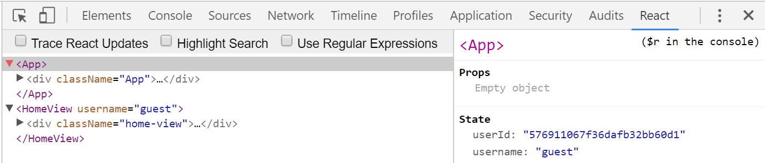
Show View in the Main App Area
showView(reactViewComponent) {
ReactDOM.render(reactViewComponent,
document.getElementById('main'));
$('#errorBox').hide();
}

Slide 45
Show Some Views
Bind the Home view with the App state to ensure updates when the state changes
showHomeView() {
this.showView(<HomeView
username={this.state.username} />);
}
showLoginView() {
this.showView(<LoginView
onsubmit={this.login.bind(this)} />);
}

Slide 46
The Navigation Bar Component
import React, { Component } from 'react';
import './NavigationBar.css';
export default class NavigationBar extends Component {
render() {
let username = this.props.username;
if (username == null) { // No user logged in
return …;
} else { // User logged in
return …;
}
}
}

Slide 47
Navigation Bar: No User Logged In
// No user logged in
return (
<nav className="navigation-bar">
<a href="#" onClick={this.props.homeClicked}>
Home</a>
<a href="#" onClick={this.props.loginClicked}>
Login</a>
<a href="#" onClick={this.props.registerClicked}>
Register</a>
</nav>
);

Slide 48
Navigation Bar: User Logged In
// User logged in
return (
<nav className="navigation-bar">
<a href="#" onClick={this.props.homeClicked}>Home</a>
<a href="#" onClick={this.props.booksClicked}>
List Books</a>
<a href="#" onClick={this.props.createBookClicked}>
Create Book</a>
<a href="#" onClick={this.props.logoutClicked}>Logout</a>
<span className="loggedInUser">Welcome, {username}!</span>
</nav>
);

Slide 49
Navigation Bar CSS
.navigation-bar {
background: #DDD;
text-align: center;
padding: 10px 5px;
line-height: 1.5;
border-radius: 3px;
overflow: auto;
}
.navigation-bar a {
text-decoration: none;
padding: 5px 10px;
border-radius: 5px;
}
.navigation-bar a:hover {
background: #BBB;
}
.navigation-bar .loggedInUser {
float: right;
margin-right: 10px;
}

Slide 50
Footer.js
…

Slide 51
Footer.css
…

Slide 52
Home View
…

Slide 53
Login View
…

Slide 54
Register View
…

Slide 55
Books View
…

Slide 56
Create Book View
…

Slide 57
Edit Book View
…

Slide 58
Delete Book View
…

Slide 59
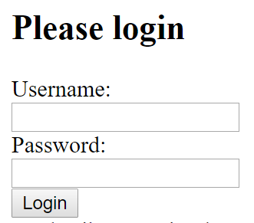
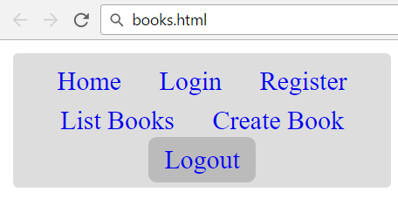
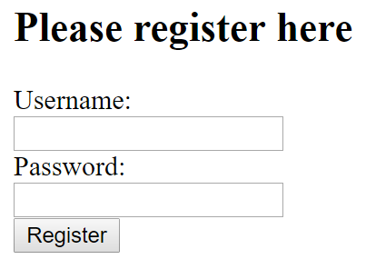
Login / Register / Logout
User Management with Kinvey

Slide 60
Kinvey Requester
…

Slide 61
Login
…

Slide 62
Register
…

Slide 63
Logout
…

Slide 64
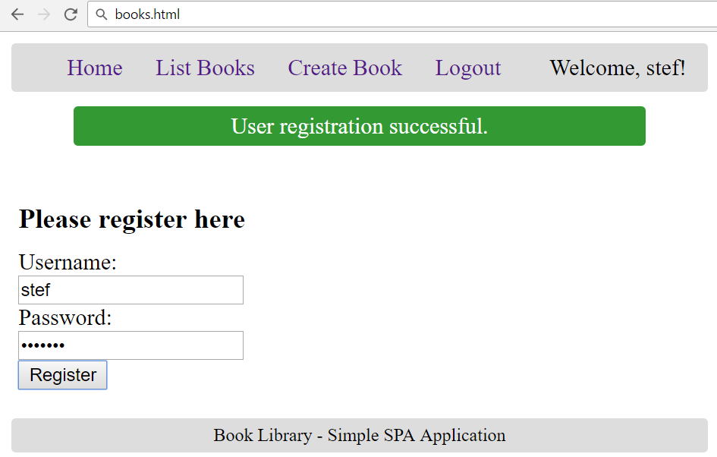
Test the User Registration: Success

Slide 65
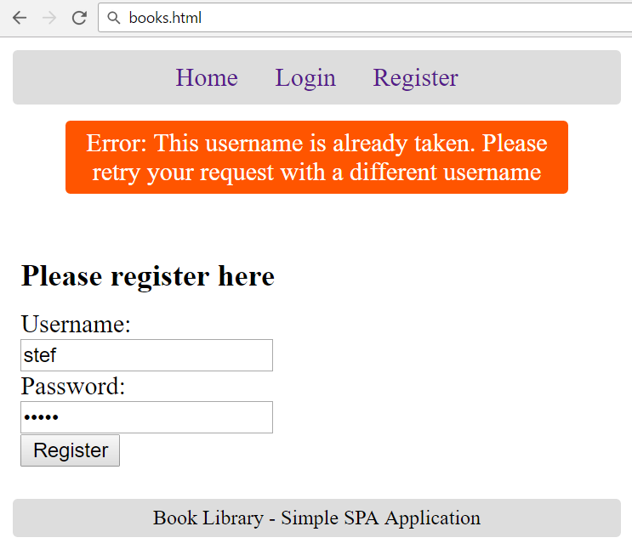
Test the User Registration: Error

Slide 66

Implementing CRUD Operations
List / Create / Delete / Edit

Slide 67
View Books
…

Slide 68
Create Book
…

Slide 69
…

Slide 70
…

Slide 71
…

Slide 72
…

Slide 73
…

Slide 74
…

Slide 75
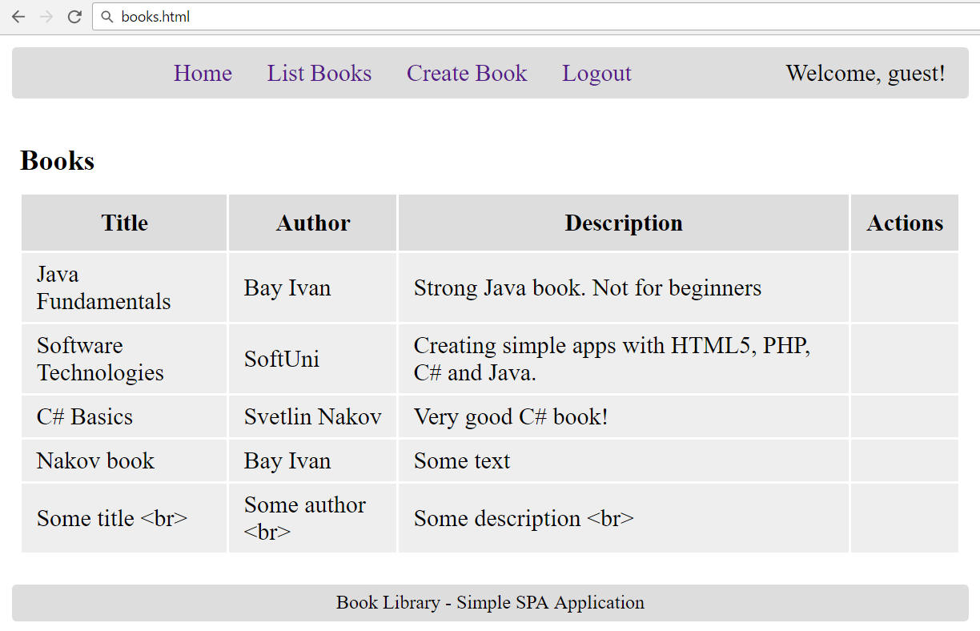
Test: List Books

Slide 76
…

Slide 77
…

Slide 78
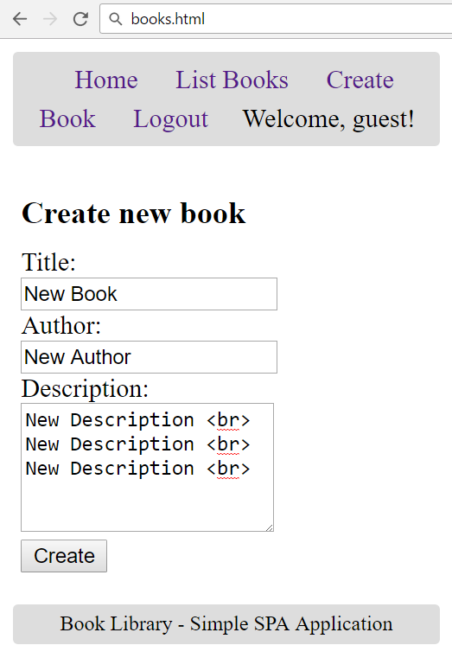
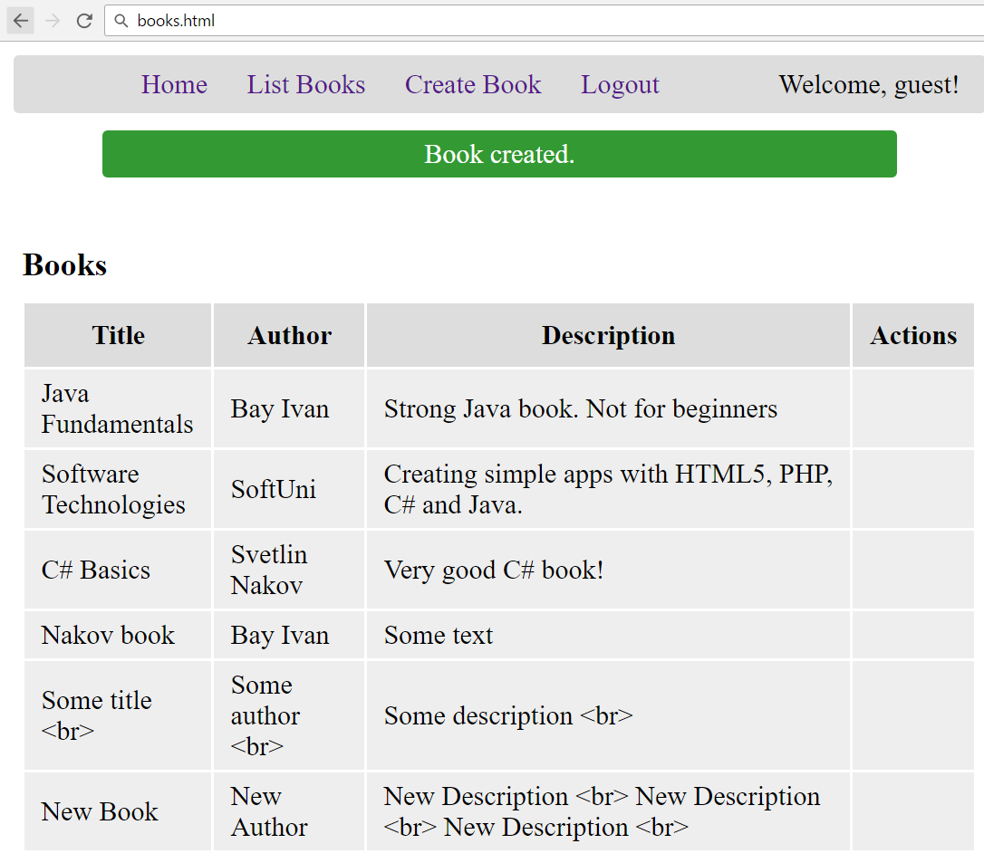
Test: Create New Book

Slide 79
…

Slide 80
…

Slide 81
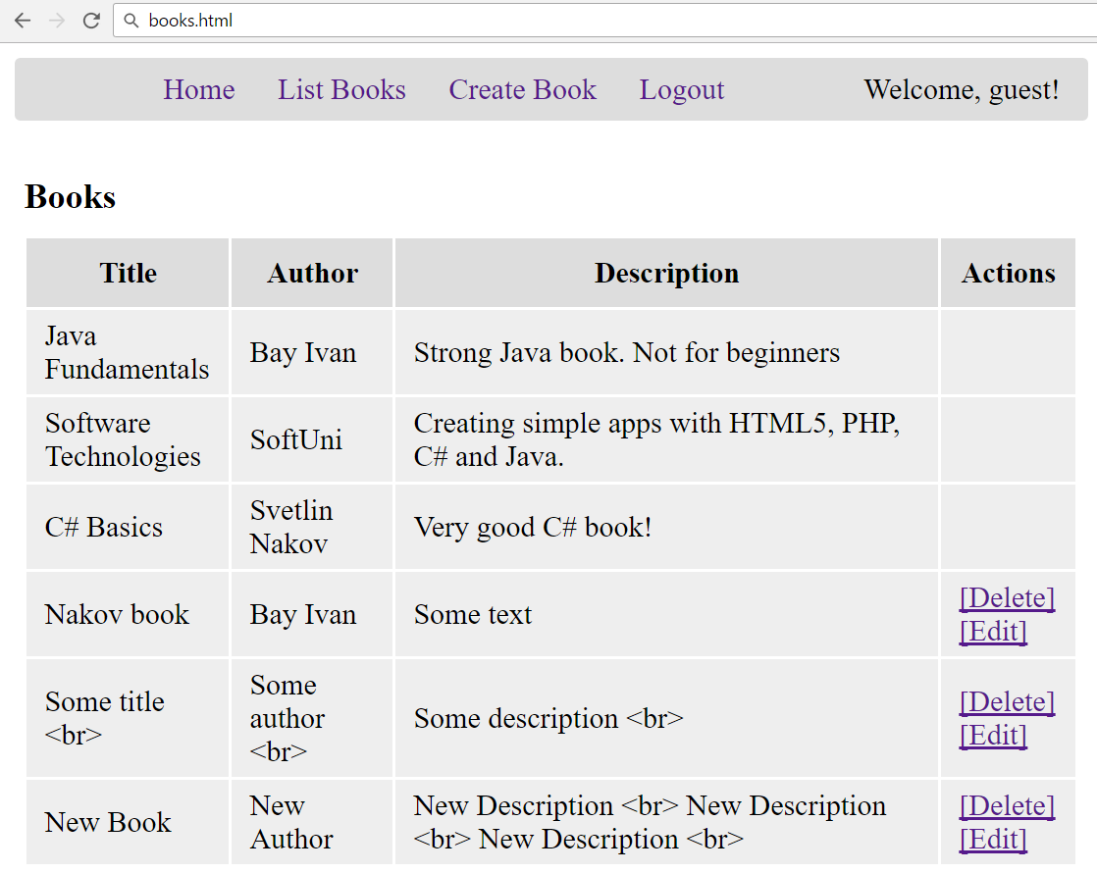
Test: Display Edit / Delete Links

Slide 82
…

Slide 83
…

Slide 84
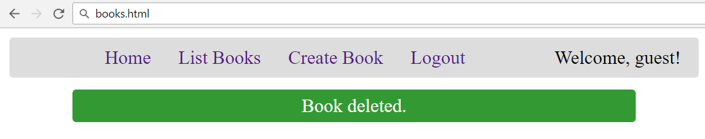
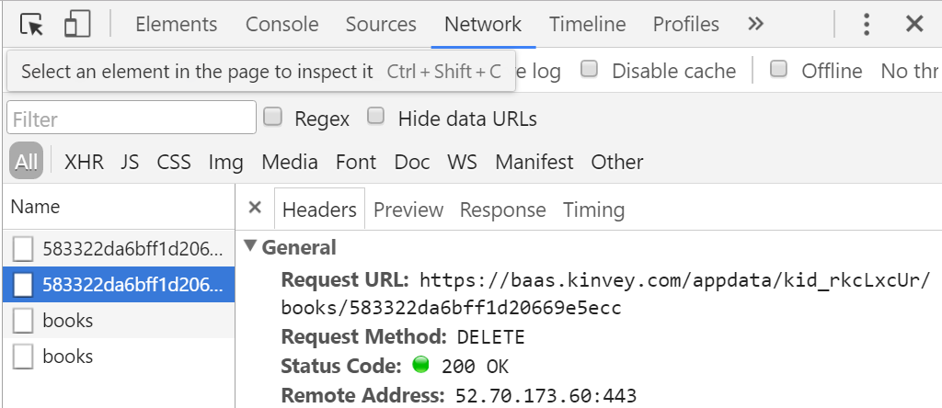
Test: Delete Book

Slide 85
…

Slide 86
…

Slide 87
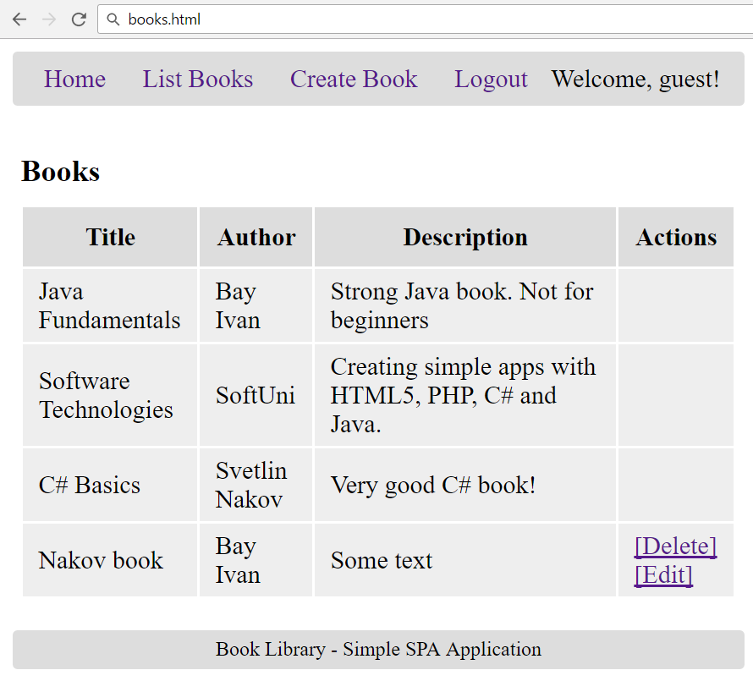
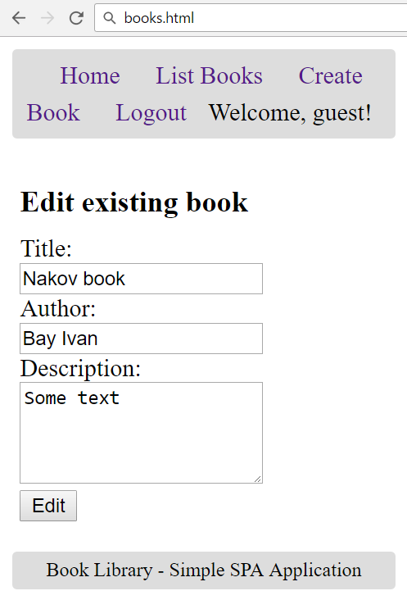
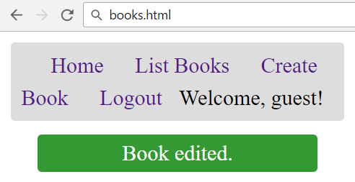
Test: Edit Book

Slide 88

Practice: "Book Library" React App
Live Exercises in Class (Lab)

Slide 89


Summary
…

Slide 90









SPA with React and REST
https://softuni.bg/courses/javascript-applications

Slide 91
License
This course (slides, examples, demos, videos, homework, etc.) is licensed under the "Creative Commons Attribution-NonCommercial-ShareAlike 4.0 International" license

Slide 92






Free Trainings @ Software University
Software University Foundation – softuni.org
Software University – High-Quality Education, Profession and Job for Software Developers
softuni.bg
Software University @ Facebook
facebook.com/SoftwareUniversity
Software University @ YouTube
youtube.com/SoftwareUniversity
Software University Forums – forum.softuni.bg

